Slide 1

Welcome year 8s!

Slide 2

Today we are going to:
Learn the classroom routines
01
Entry and exit
pop stick names
Organise our workbooks
02
Introduction to our first topic: Integers: 4 Operations
03
Whiteboards
Expectations

Slide 3


What are our expectations?
Arrive on time for lessons
Line up sensibly outside and enter the classroom quietly
Make sure you have the correct equipment / books out on the table
Listen carefully to instructions
No shouting out
No talking when others are talking - whether it's the teacher or another member of the class
Be respectful at all times and show empathy to each other
Positive, hard-working attitude - consequences
All lesson tasks / activities must be attempted - effort
All homework must be completed when required

Slide 4
Entering the classroom
Please no food or phones
Hats off
Come in quietly, find your file and sit down
Write down the lesson purpose/objective (on the board)

Slide 5
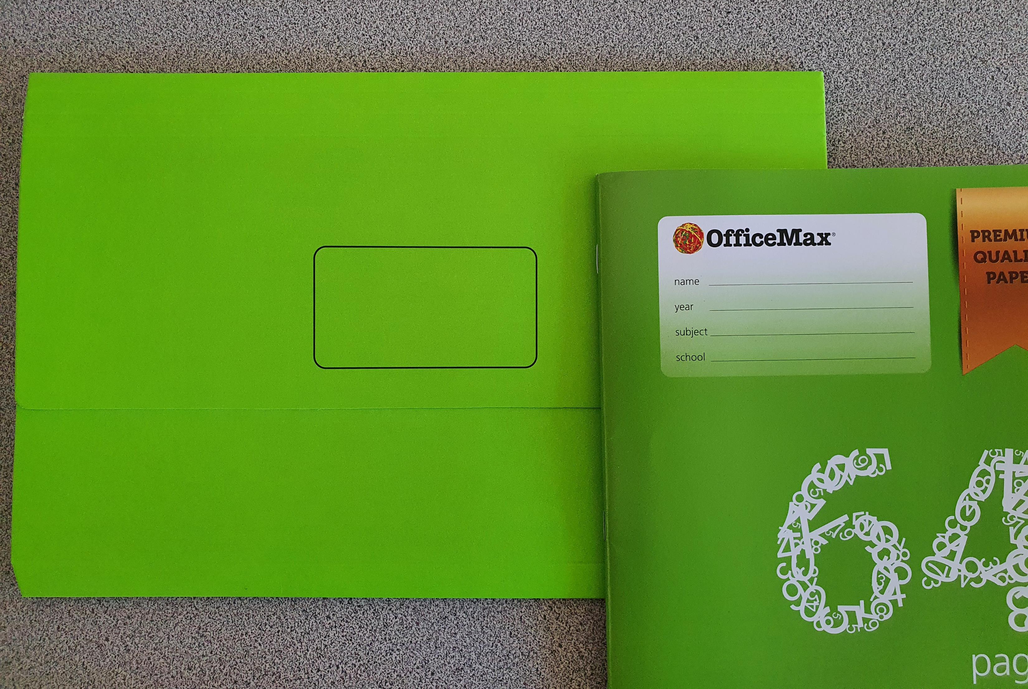
Please put your name on BOTH folder and exercise book

Slide 6
Standards
This is how you are expected to complete work and notes.

Slide 7
Setting up our personal whiteboards
Each person needs:
Plastic sleeve
1 piece of card
1 piece of grid paper
1 piece of isometric paper
Write your name on the top right of the grid paper, so you can see it.
Place the paper and card into the plastic sleeve so that the card is in the middle and is covered by the other pieces of paper.

Slide 8
Whiteboard routine
What I do
What you do
Give you the question
“hover when ready”
“chin it”
“bin it”
8 – 10 seconds to write an answer
Whiteboard hovering over your desk
Show me your answer
Clear your answer, ready for next question

Slide 9
Quick math whiteboard practice
Answer the following questions on your whiteboards:
5 x 5 =
How many degrees in a right angle?
7 – (-4) =
What is 10% of 350?

Slide 10

Lesson objective
Title: Integers: 4 operations
Today we are going to describe the 4 operations.
Success criteria:
I have created my folding notes with examples.
I can perform the 4 operations with integers.
Notes:
Explain where to start in the book for each lesson (most recent page), the date and topic title

Slide 11


Slide 12
Choral response
Good learners go into the pit and come out of the pit with new learning, ready for the next challenge.
Good ______ go into the pit and come out of the pit with new learning, ready for the next challenge.
Good ______ go into the pit and come out of the pit with new learning, ready for the next _______
What do good learners do? (pop sticks)

Slide 13
Quick math whiteboards
Hover
Chin it
Bin it (clean the board)

Slide 14

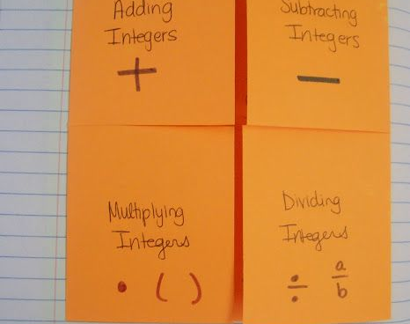
Foldable operations notes

Slide 15
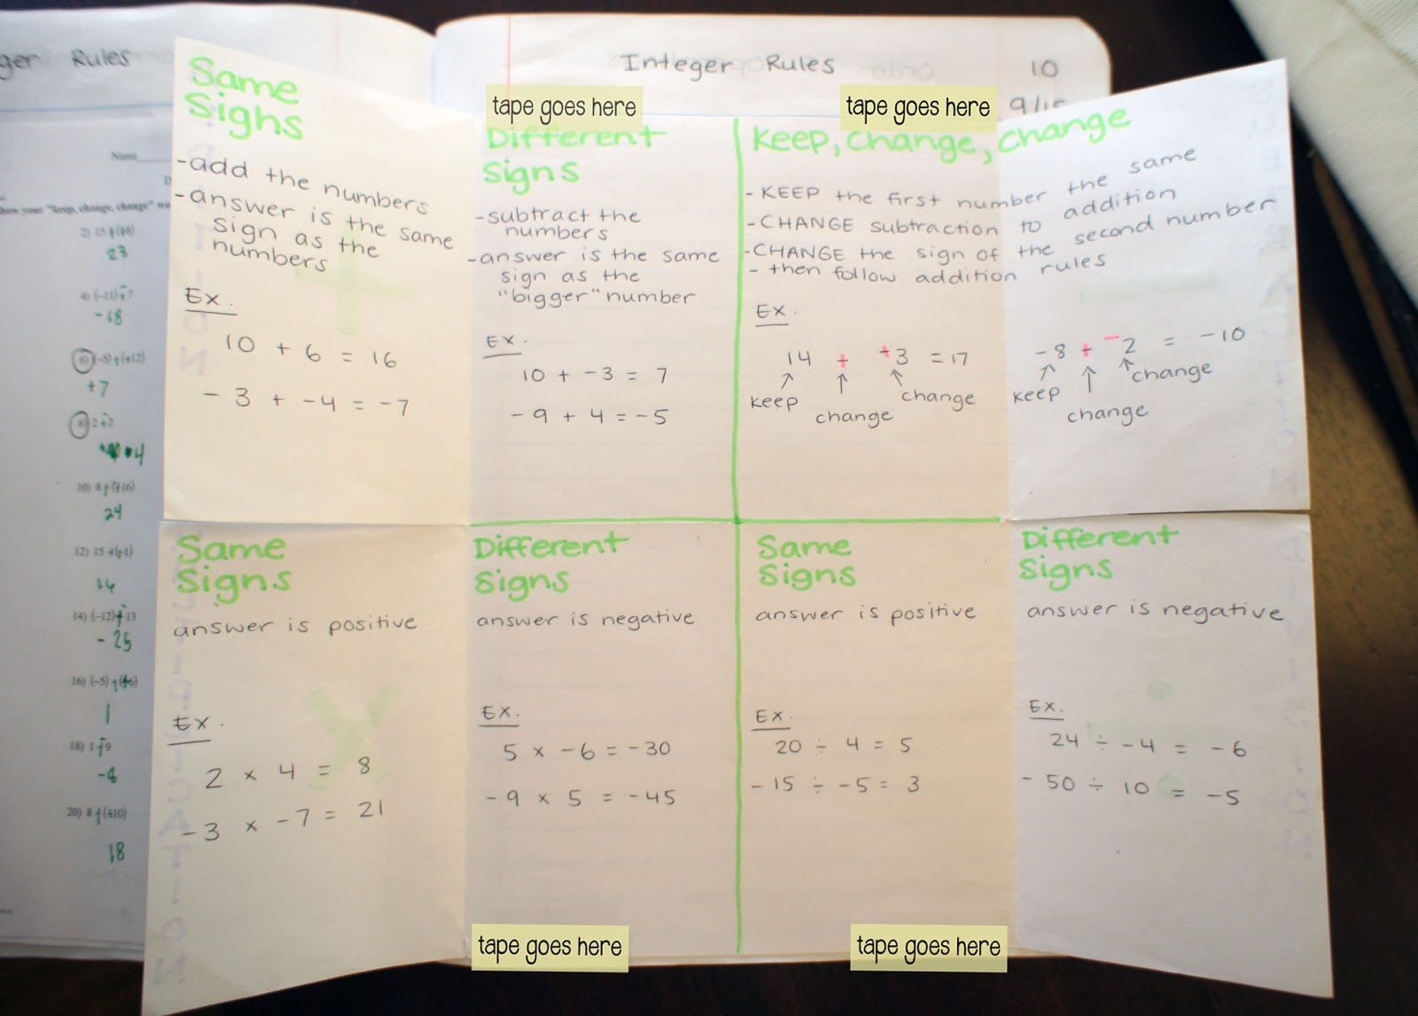
Foldable operations notes

Slide 16
How to make our notes
Have the paper landscape (long sides)
Fold the paper in half, both horizontal and vertical (see e.g)
Fold the outsides into the middle line
Unfold and cut the paper up to the folded line (see e.g)
Tape/glue the paper into your exercise book
Begin notes

Slide 17
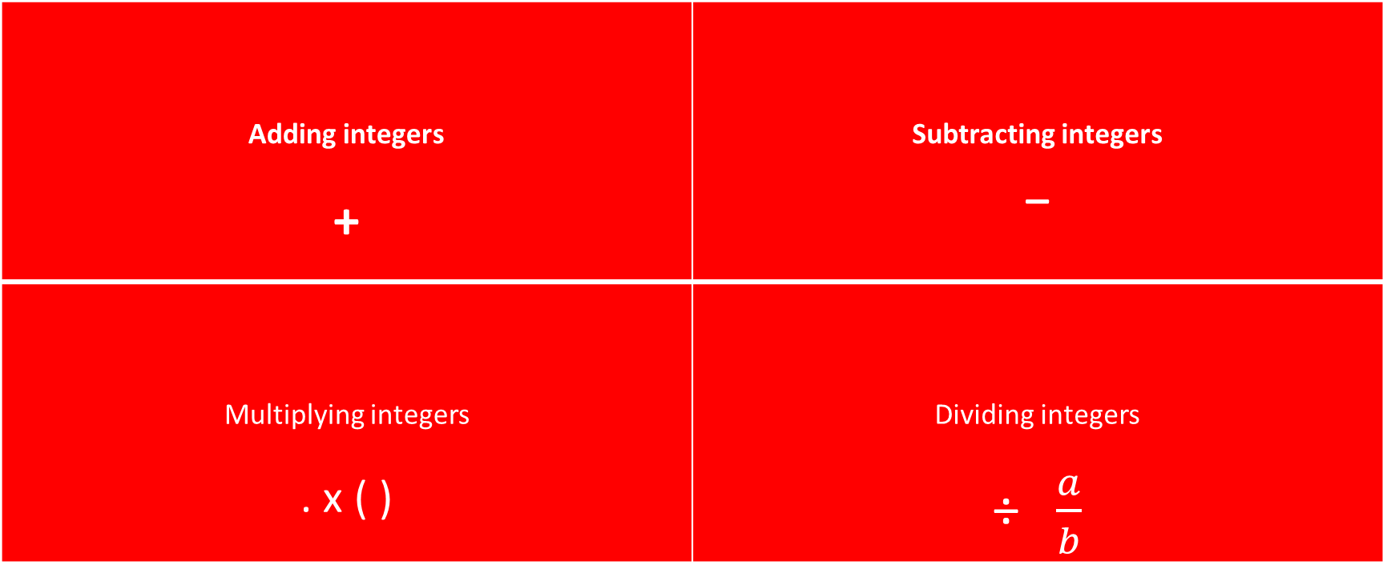
Front section
Adding integers + | Subtracting integers _
Multiplying integers . x ( ) | Dividing integers ÷ $\frac{a}{b}$

Slide 18
Inside: the important stuff
Same signs Add the numbers Answer is the same sign as the numbers E.g. | Different signs Subtract the numbers Answer is the same sign as the “bigger” number E.g. | Keep, change, change KEEP the first number the same CHANGE subtraction to addition CHANGE the sign of the other number Then follow addition rules E.g. 14 – (-3) ➔ 14 + 3 = 17 (demo number line) (-8) – 2 ➔ (-8) + (-2) = -10
Same signs Answer is positive E.g. | Different signs Answer is negative E.g. | Same signs Answer is positive E.g. | Different signs Answer is negative E.g.
What would happen if we multiplied 3 negative numbers?

Slide 19
Success criteria
I have created my folding notes with examples.
I can perform the 4 operations with integers.

Slide 20
End of lesson routine
Pack up, neatly
Seat quietly
Wait for teacher to dismiss

